Slide 1
2023 Session Wrap-up Briefing AWC Government Relations

Slide 2
2023 Legislative Session
105-day Session: January – April; Special Session May 16
New legislators, new committees, new Chairs, 40 legislators with city/county background
Biennial budgets: Operating, Capital, Transportation
Policy focus: housing, workforce, drug policy, gun violence
Democrat majorities: 29-20 Senate, 58-40 House
Economic environment: positive revenue forecasts, slowing economy, high interest rates, inflationary pressure
Notes:
Last few days of session - Sine Die is on Sunday, April 23.
Budgets are usually some of last bills remaining before adjourn – rumor is Saturday.
Governor has 20 days excluding Sundays to sign or veto bills.

Slide 3
Respond to the Blake decision
Support funding for local impacts resulting from the Blake decision response and provide clarification around the crime of possessing a controlled substance so that individuals, law enforcement, and treatment providers can respond appropriately.
Address vehicle pursuits for public safety
Clarify the ability for law enforcement to conduct vehicle pursuits using a reasonable suspicion standard in specific circumstances.
Ensure basic infrastructure funding
Fully fund the Public Works Assistance Account (PWAA), allow the current revenue diversions to sunset at the end of fiscal year 2023, and refrain from further fund transfers or diversions to other infrastructure programs or non-infrastructure accounts.

Slide 4
Increase housing availability & affordability
Support a proactive approach that creates new tools, incentives, and revenues that cities can use to help increase housing supply and address affordability.
Provide behavioral health resources
Create greater access to community-based behavioral health services to include substance use disorder treatment and dual diagnosis treatment facilities.

Slide 5
AWC Legislative Significant Issues
Revise the property tax cap
Transportation funding
Growth Management Act (GMA) planning & permitting revisions
Water rights
Culverts – fund local fish barrier removal
Public safety funding
REET flexibility and authority
Public Records Act updates to reduce litigation

Slide 6
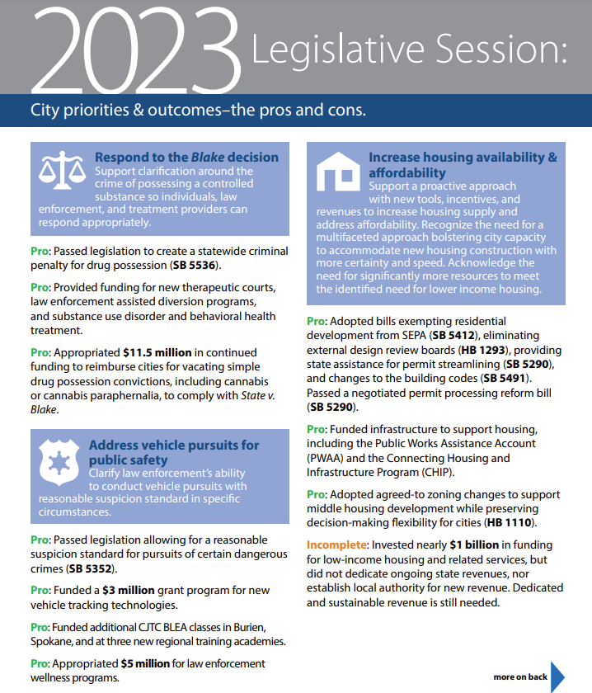
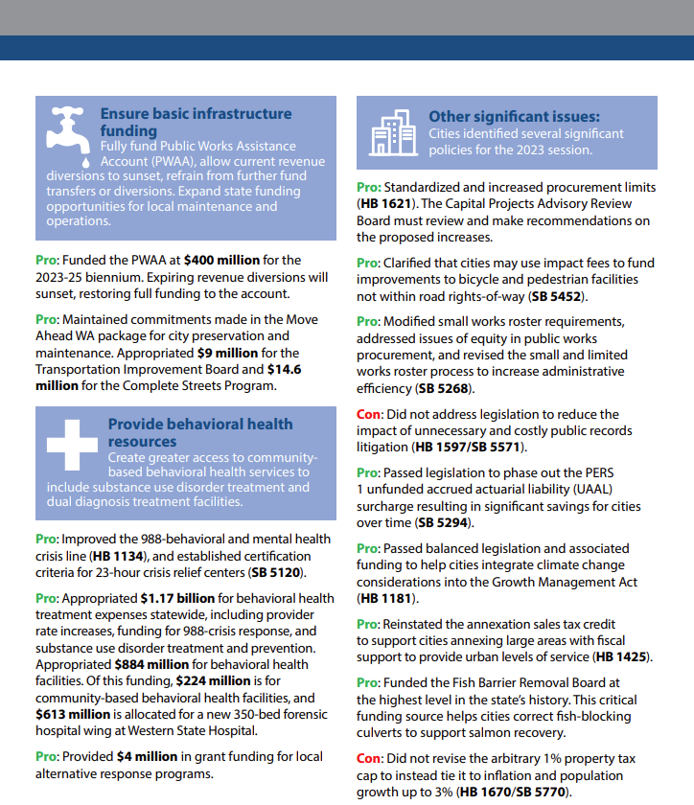

Slide 7
2023 Budget Outcomes
Operating
Additional BLEA classes
Continued funding for Blake cases
Transportation
$287 million for TIB
Capital
$400 million for the Housing Trust Fund
$200 million for broadband
Alternative response grants
Housing & homeless assistance
$60 million for CHIP
Additional Drinking Water Assistance Account funding
$25 million for CERB
Fully funded the PWAA
$150 million to move people from encampments
$70 million Safe Routes to Schools
$1 billion for state and local culverts
$23.7 million for pilot federal funds exchange
$2.5 million for truck parking sites
Study of a statewide retail delivery fee
Study of collaborative partnerships on local delivery of state projects
Diversion program grants
Behavioral health investments
$48.4 million for culverts
$211 million for behavioral health capacity grants
$45.7 million for FMSIB

Slide 8
Housing bills
Proactive approach this year
AWC Housing Solutions Group proposals
Passed
HB 1110 – Middle housing & density mandate.
HB 1042 – Conversion of existing commercial and mixed-use buildings for residences.
HB 1046 – Increases AMI threshold for housing authority projects to 80%.
HB 1293 – Objective design review.
HB 1250 – Low-income home rehabilitation program reform.
HB 1267 – Rural public facilities tax with workforce housing nexus.
HB 1326 – Can waive utility connection fees for certain housing and shelter.
HB 1337 – ADU mandate.
HB 1425 – New version of the annexation sales tax credit.
HB 1474 – Covenant homeownership program.
HB 1695 – Broadens definition of affordable housing under surplus property law.
Notes:
*No later than six months after next comp plan update.
HB 1110* – Middle housing & density mandate.
HB 1042* – Conversion of existing commercial and mixed-use buildings for residences. Allows for a 50% increase in density if within the existing building envelope. Must still meet health and safety codes. Parking and design standards restrictions. SEPA exemption.
HB 1046 –Increases AMI threshold for housing authority projects: The low-income dwelling units or mobile home lots of a PHA financed development owned by a for profit entity, government entity, or a nonprofit organization must be rented to persons whose income does not exceed 80 percent of the area median income
HB 1293* – Objective design review
HB 1326 – Can waive utility connection fees for emergency shelter, transitional housing, permanent supportive housing, or affordable housing.
HB 1337* – ADUs.
HB 1425 – Establishes a new version of the annexation sales tax credit to incentivize annexation of UGAs.
HB 1474 – Adds $100 to document recording fee to create the covenant homeownership account and program to address the history of housing discrimination due to racially restrictive real estate covenants.
HB 1695 – Broadens definition of affordable housing under surplus property law. Instead of just low-income and very low income, now includes income limits based on whether rental or permanently affordable homeownership.

Slide 9
Housing bills
Passed
SB 5058 – It’s not a condo!
SB 5290 – Local project review.
SB 5604 – Amends HB 1406 (2020) sales tax credit to allow all cities to use revenue for rent assistance.
SB 5258 – Increasing condos and townhouses for homeownership.
SB 5386 – Document recording fees.
SB 5412 – Exempting housing development consistent with a comp plan and when environmental analysis is completed from SEPA.
SB 5491 – Residential building exits.
Notes:
SB 5058 – A building with 12 or less units that is no more than two stories high is exempt from building enclosure design or inspection.
SB 5290 – Local project review. Provides a grant program to consolidate local permit process, including switching to online. Requires local governments to exclude interior alterations from site plan review under certain conditions. Outlines permit completeness, notice, and timelines process, and allowable exemptions and alternative compliance. Requires annual performance reporting.
SB 5604 – Removes the population limitation for spending HB 1406 (2020) sales tax credit revenues for rental assistance, and caps admin fees at 10% annually.
SB 5258 – Increasing condos and townhouses for homeownership. Mainly to address/reduce condo liability but also includes a mandate regarding impact fee calculations and procedures for unit lot subdivisions allowing for division of a parent lot into separately owned unit lots in their short plat regulations.
SB 5412 – Categorical exemption for all residential housing units within incorporated areas if consistent with comp plan.
Did not pass:
HB 1628 – Creates a new 0.25% local option real estate excise tax (REET) & state REET increase on values over $5 million for affordable housing.

Slide 10
Housing bills
Did not pass
HB 1111 – Housing benefit district
HB 1149 – $4 billion bond bill & Workforce Housing Accelerator Loans
HB 1245 – Lot splitting
HB 1628 – New 0.25% local option real estate excise tax (REET) & new state REET tier
SB 5466 – Transit oriented development density mandates
Plus, multiple competing bills on local permit processing and housing regulations.

Slide 11
Environment & Transportation bills
Passed
HB 1544* – Planning timeline extension of Shoreline Management Act.
HB 1085 – Reducing plastic pollution – bottles, docks, toiletries.
HB 1138 – Drought preparedness projects.
HB 1181 – Integrating climate change into the Growth Management Act.
SB 5457* – Small city (500 pop) opt out of GMA plan update.
SB 5452 – Allows use of transportation impact fees for bicycle and pedestrian facilities not within ROW.
*Unicorn! No amendments and unanimous passage in both chambers.
Notes:
HB 1544 – Planning timeline extension of Shoreline Management Act (bumps a year for next update, then every 10 years instead of 8)
HB 1085 - Reducing plastic pollution –bottles, docks, toiletries.
HB 1138 – Drought preparedness projects can include planning and don’t need to be completed while a drought emergency order is in effect.
HB 1181 – Integrating climate change into the Growth Management Act.
SB 5452 – The definition of public facilities is amended to add bicycle and pedestrian facilities that were designed with multimodal commuting as an intended use. This provides clarity that these fees can be used on bike/ped facilities not within a ROW.
SB 5457* – Small city (500 pop) opt out of full review and update of GMA plan, if criteria met. Must update CAOs, cap facilities, and transportation elements.

Slide 12
Open Government bills
Passed
HB 1533 - Exempts from PRA disclosure info on public employees that are survivors of domestic violence, sexual assault, and other crimes, or are in the address confidentiality program.
Did not pass
HB 1080 – Allows charge for cost of redacting body-worn camera footage if requestor entitled to no-cost, unredacted copy.
HB 1105 – Notice of deadlines for public comments.
HB 1597/SB 5571 – Intended to reduce frivolous public records act lawsuits
Notes:
1080: Allows charge for cost of redacting body-worn camera footage where the requestor is entitled to a no-cost, unredacted copy, e.g. criminal defense discovery. article
1105: Require public agencies to include the beginning/end date/time of a public comment period on notice. First time civil penalty $500, subsequent $1000. AWC worked with the bill sponsor to address unclear language in the first version of the bill and ensure that the requirement only applied in situations where there is a statutorily identified time period for public comment. article
1597/5571: Intended to reduce the number of frivolous lawsuits by focusing on administrative problem-solving before a requester can file a lawsuit. article

Slide 13
HR & Labor Relations Bills
Passed
SB 5286 – Changes formula used for calculating PFML premiums, raises cap to 1.2%, and other changes.
SB 5586 – Permits ESD to share certain PFML claims data with employers, including type of leave, approved dates/duration of leave, & whether benefits were approved for a given week.
SB 5217 – Permits L&I to adopt rules to prevent ergonomic injuries, up to one set of rules per year per industry or risk class.
SB 5123 – Prohibits preemployment drug testing for marijuana for many jobs, but not for certain safety sensitive jobs
HB 1187 – Creates a broad new legal privilege between unions and employees.
HB 1200 – Requires public employers to provide certain employee info to unions, within 21 days for new hires and every 120 days for all employees in a bargaining unit.
HB 1521 – Creates a “good faith” standard for municipal employers that self-insure for workers’ comp, with penalties for violation.
Did not pass
HB 1320 – Requires employers to turn over a complete copy of an employee’s own personnel record on request within 15 days of the request.
Notes:
5286 – came out of the unanimous recommendation of the interim PFML Insurance Premiums Task Force to help avoid the cash flow problems experienced by the PFML program during 2022
5217 – Repeals 20 year old initiative that banned L&I rules to prevent musculoskeletal injuries. Limits the number of new rules L&I can put in place in a given year.
5586 – lets employer access more claims data on their employees' PFM leave. Employers have been wanting access to this data for a while to help manage their own leave and benefits programs.
1187 - very broad privilege that was adopted. Allows unions to testify in court for their members, but not be subject to discovery or cross examination. Also, the privilege is held by both the employee and the union itself.
1521 - the scope of the bill was narrowed to only municipal self insured employers, as most of the denied claims that gave rise to the bill were in re city firefighters. Provisions to allow a private right of action were removed.
1200 - Includes exceptions for employers with US DoD clearances that specifically prohibit sharing employee records.
1320 - Cities were concerned with the short compliance timelines, private right of action, and broad definition of "personnel records" that would have captured many more records then under current law.

Slide 14
Pensions Bills
Passed
SB 5294 – Scales back and eventually ends unfunded liability surcharge by 2027.
SB 5350 – One-time, ad hoc COLA for PERS 1 retirees, capped at 3% or $110/month. Directs Select Committee on Pension Policy to study and make recommendations on permanent PERS 1 COLA.
HB 1056 – Permits early retirees under 2008 ERFs to work in PERS-covered position for up to 867 hours/year without suspension of retirement benefits.
HB 1007 – Expands definitions for veteran’s benefits for pensions, civil service scoring, etc. to include any armed conflicts where an expeditionary medal was awarded.
Did not pass
HB 1459 – Establishing a permanent, automatic annual COLA for PERS 1 retirees, capped at 3%.
SB 5424 – Allows police depts. to adopt flexible work programs and permits part-time officers to participate in LEOFF 2 and exercise full mutual aid police powers.

Slide 15
Public Safety and Criminal Justice Bills
Passed
SB 5352 – Allowing law enforcement to engage in a vehicular pursuit when there is a reasonable suspicion of certain crimes, and establishing safety requirements for engaging in pursuits.
SB 5536 – State v. Blake fix to address criminality of drug possession.
HB 1240 – Assault weapons ban.
HB 1715 – Establishes new parameters for domestic violence cases.
SB 5606 – Expands the definition of "street racing."
HB 1028 - Among other things, modifies the requirements for DNA sample collection in jails.
HB 1169 - Eliminates the DNA database fee and allows for waiver of previously imposed fee.
HB 1209 - Creates a class C felony for possession or sale fentanyl tableting or processing equipment.
HB 1312 - Jurors age 80+ can be automatically excused for medical reasons.
Did not pass
HB 1493 – Would have made numerous changes to prosecution of impaired driving.

Slide 16
General Government bills
Passed
HB 1048 – Voting Rights Act amended – more opportunities for groups to bring challenges.
HB 1086 - Increases public agency contract limits with community service organizations to $75,000 or $2 per resident.
HB 1234 - clarifies authority for law enforcement agencies and local animal care and control agencies to take possession of an abused or neglected animal.
HB 1577 – Limit for city contracts with municipal officers or their businesses raised to $3000 per month, had not changed since 1999.
Did not pass
HB 1025 – Eliminated qualified immunity and created new civil cause of action against police and departments for violating the state constitution or certain state laws.
HB 1445 – Attorney General investigations and actions against police departments for violations of state constitution or law. Required AGO model policies on police conduct.
HB 1650 – Voter approval for local prohibitions on the operation and siting of cannabis businesses after July 1, 2027. Only elections after July 1, 2023, would have qualified.
SB 5059 - Required prejudgment interest on tort claims going back to the time of injury.
Notes:
1048 VRA – more litigation likely; bill covers costs whether or not lawsuit up to $50,000 if lawsuit. Grants standing to orgs/tribes with at least one voter in the subdivision, coalition of protected classes. Allows for increase in number of county commissioners as remedy based on tribal status. article
1086 Allows cities to contract with community service organizations for different projects include park maintenance, environmental stewardship, installing artwork or other similar activities. Annual total contract limit increased from $25,000 to $75,000 or $2 per resident.
1521
1577 Increases contract limits between cities and city officers from $1,500 per month to $3,000 per month. For second-class cities, town, or noncharter optional code city, limit allows for more than $3,000 per month but is limited to $36,000 per year.
1025/1445 - we expect to see some version of these back again.
1650 – sponsor wants to bring this back again in the future. article

Slide 17
Public Works & Infrastructure bills
Passed
PWAA – Budget fully funds at $400 million, sunsets current diversions.
Did not pass
SJR 8201 & SB 5303 – Would have amended the State Constitution to establish the Public Works Revolving Account in the state Treasury.
HB 1099 – Would have required that wages paid to workers of public works projects be no less than the latest prevailing wage rate in effect at the time the work is performed.
Passed
HB 1621 – Increases contract limits that require competitive bidding; allows current employees to perform work following accepted industry practice without a contract; outlines a standard definition of “lowest responsible bidder."
Notes:
HB 1251 – Requires a public water system to notify customers and the Department of Health of intentions to start or stop water fluoridation
HB 1329 – Drafted in partnership with AG’s office to prevent a repeat of the 157 heat related deaths in WA in 2021. Utilities and landlords may require a residential user to agree to a payment plan prior to reconnecting service.
HB 1621 – Implementation of the bill delayed until CPARB formally reviews and recommends the legislation. Takes effect June 30, 2024, pending CPARB review.
HB 1050 – The phased in approach was introduced and adopted by the Senate, but the House does not concur, so they’re currently negotiating.

Slide 18
Public Works & Infrastructure bills
Passed
HB 1050 – Municipal public works projects of $1,000,000 or more must have at least 15% of the labor hours performed by apprentices. Requirement phased in through 2028.
SB 5268 – Removes barriers for small businesses to bid on public works projects; modifies small-works roster procedures to be more inclusive and efficient; directs MRSC to develop a statewide small-works roster.
HB 1329 – Prohibits water and electric utility shutoffs during periods of extreme heat. Allows customers previously disconnected from service to request reconnection during said periods.
Notes:
SB 5088 – At the time of bid submittal, a bidder must have a certificate of registration. This bill adds a plumbing contractor license, an elevator contractor license, or an electrical contractor license as legitimate for meeting responsible bidder criteria.
SB 5268 – Consensus bill from the Capital Projects Advisory Review Board (CPARB). Directs Commerce, through MRSC, to develop a statewide small works roster. Aligns the state’s definition of small business with that of the Office of Minority and Women’s Business Enterprises (OMWBE) to promote greater equity in the public works procurement process.

Slide 19
Finance & Economic Development bills
Passed​
HB 1267 – Extends rural county economic development sales tax (.09) to 2054.
HB 1527 – Technical changes to local tax increment financing program.
Did not pass
SB 5770, HB 1670, SB 5618 – Revised the property tax cap to inflation and population up to 3%.
SB 5361 – Authorized cities to impose additional 0.1% sales tax for employing additional law enforcement officers. Eliminated 25% cost-sharing for BLEA.
SB 5289 – Authority to charge impact fees for law enforcement facilities.
HB 1644/SB 5482 – Replaced the state B&O tax with a new margin tax. Did not directly impact tax authority for cities.
Notes:
HB 1267 – several counties near cap on authority of 25 years after imposition or now population grown above population limit for "rural". Cities receive funding for development projects. (may pass before presentation)
Property tax cap fix (SB 5770, HB 1670) and margin tax proposals recommendations of ongoing State Tax Structure workgroup. Cities represented by Vancouver Mayor Anne McEnerny-Ogle
While SB 5361 did not pass, the budget included funding for new BLEA classes, including several regional class locations to lower costs and travel burden for training.

Slide 20
Being a Strong City Advocate Year-round
Regular advocacy
Invite legislators for post-session debrief
Tell your city story all year long
Develop your legislative agenda
Stay connected all interim
Use AWC tools & resources
https://wacities.org/advocacy/advocacy-tools
Notes:
May 18 session recap webinar with AWC's lobbyists; Recap bulletin May 22

Slide 21
Looking ahead to 2024
Election year
Supplemental budgets
AWC Legislative Priorities Committee beginning work
Have an idea/issue – share it with us via our survey

Slide 22
Government Relations Team
Candice Bock Director (360) 951-5390 Issue areas – Economic development; federal; finance; human resources, labor relations; pensions; open government; liability Carl Schroeder Deputy Director (360) 485-7604 Issue areas – Environment & natural resources; housing & homelessness; land use & planning; building codes Lindsey Hueer Advocate Issue areas – Public safety & criminal justice; cannabis; emergency management; cybersecurity; general government; human services & behavioral health; elections Brandy DeLange Advocate (360) 515-8360 Issue areas – Public works & infrastructure; telecommunications; transportation; utilities & energy Amy Davis Assistant Legislative Bulletin, committee support, team logistics | Sheila Gall General Counsel Issue areas – Municipal finance & taxes Matt Doumit Legislative Policy Analyst Issue areas – Human resources; labor relations; pensions; liability Shannon McClelland Legislative Policy Analyst Issue areas – Environment & natural resources; housing & homelessness; land use & planning; building codes Katherine Walton Legislative Policy Analyst Issue areas – Public safety & criminal justice; cannabis; emergency management; cybersecurity; general government; human services & behavioral health; open government; elections Brianna Morin Legislative Policy Analyst Issue areas – Public works & infrastructure; telecommunications; transportation; utilities & energy Jacob Ewing Special Projects Coordinator Issue areas – American Rescue Plan Act (ARPA); parks; economic development
Notes:
Candice

