Slide 1
Sales Tax and General Fund Forecasting
PSFOA August 12, 2020
T. Robert Hamud, MPA
Finance Director

Slide 2
Introduction
Major Base Revenue Sources for Washington State Local Governments:
Property tax
Sales tax
Utility tax
Optional Taxes for Local Governments:
Councilmatic
1% annual increase in property tax levy limit
Utility taxes up to six percent on private utilities, no limit on Public Utilities.
Business license fees including license pricing, square footage, head taxes.
Establishment of a local business & occupation tax (B&O).
.1% affordable housing sales tax. (effective June 11, 2020)
Voter-Approved
.2% sales tax for transportation benefit districts (voter-approved).
.1% public safety sales tax.
Property tax levy “LID” lifts.

Slide 3
Introduction to Local Government Revenue Forecasting
Staff should be forecasting long-term.
Do not assume county or regional forecasts will completely fit your city.
Evaluate your General Fund major revenue sources, what are your first, second, third revenue sources?
Sales tax currently key focus of ongoing revenues as it is the most volatile and the most impacted by the COVID pandemic as well as every other downturn.
Sustainable revenue sources reduce and/or eliminate the tendency for governing bodies to make abrupt decisions.

Slide 4
Property Tax- Forecast Changes
Assessed values have increased in King County in 2020 over 2019 by 5.92% ($35.9 billion).
Delayed property tax collections should not impact long-term revenue forecasts. (ex. Snoqualmie always budgets 2.5% lower than total taxable value due to uncollected/delinquent accounts)
King County economic forecast estimating a 2.29% increase in assessed value in 2021 and a decrease in 2022 growth forecast due to less construction, potentially lower property values.
New construction in King County forecasted to drop 25% in 2021, 10% in 2022, respectively.

Slide 5
Property Tax- Forecast Tips
Look at your assessed values in your city, ask the following questions:
  Has the council passed the 1% annual allowable property tax increase?
  If not, do you have banked capacity you can propose using?
  Does your city anticipated new construction (assessed, non-government) coming onto the tax rolls in upcoming years?
  If so, has there been a change in construction projections since COVID, project delays, etc.?

Slide 6
Example: Snoqualmie Property Tax Forecast
*Baseline forecast and options requiring council approval: 1% annual increase, also approval of a proposed, mixed-use development.

Slide 7
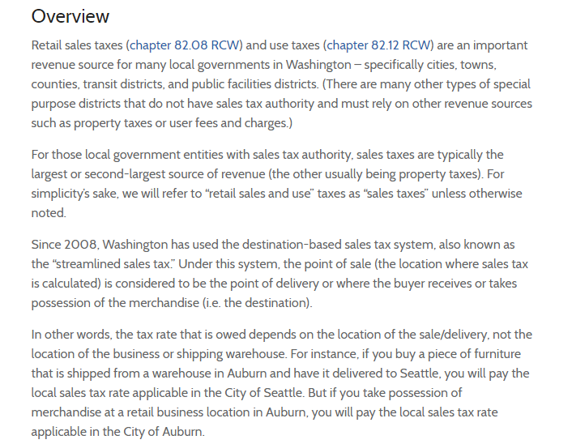
Sales Tax Forecasting: Introduction
*Source MRSC

Slide 8
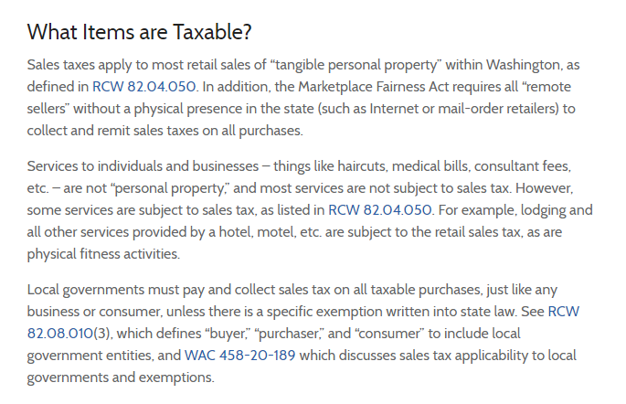
Sales Tax Forecasting: Introduction (Cont’d)
*Source MRSC

Slide 9
Combined Sales Tax Rates in Puget Sound
Auburn (King) 10%
Bellevue 10%
Bremerton 9%
Bothell (King) 10%
Des Moines 10%
Everett 9.8%
Gig Harbor 8.5%
Issaquah 10%
Lake Stevens 9%
Maple Valley 8.6%
Mill Creek 10.5%
North Bend 8.9%
Olympia 9.3%
Puyallup 9.9%
Seattle 10.1%
Snoqualmie 8.6%
Tacoma 10.2%
Tumwater 9.3%
Woodinville 10%

Slide 10
Breakdown of Sales Tax- City of Seattle

Slide 11
% Local Sales Tax of General Fund Budgets

Slide 12
Retail Changes Since Covid
Increases:
Stores that did not close during shutdowns:
  Food markets (Safeway, QFC, convenience stores)
  Miscellaneous retailers (Costco, Target, Fred Meyer, Wal-Mart)
  Construction (Home Depot, Lowes, lumber yards, nurseries)
E-Commerce 18.4% increase nationwide Jan-June 2020 over Jan-June 2019.
Decreases:
Retail stores that closed during shutdown:
  Largest Impacts: clothing, electronic stores, furniture stores.
Bars and restaurants

Slide 13
Nationwide Trends- Sales Tax
*Source: US Census Monthly Retail Trade

Slide 14













Massive Retail Changes-Store Closures

Slide 15
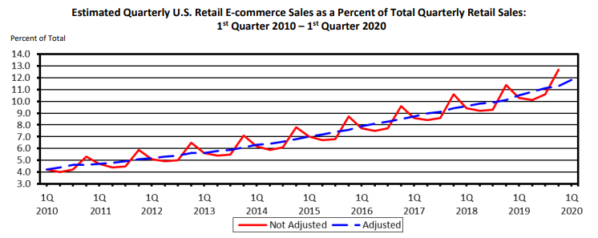
Long-Term Trend E-Commerce
*Source: US Census Quarterly E-Commerce Report: www.uscensus.gov/retail

Slide 16
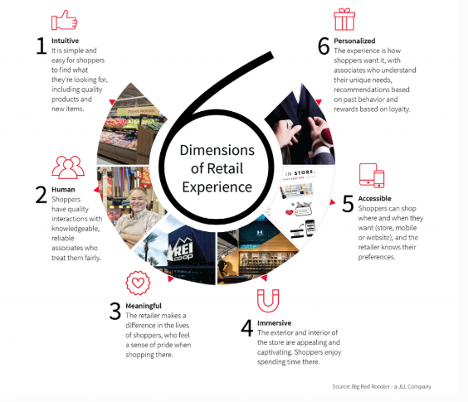
Changing Retail Landscape “Experiential”-Pre Covid
https://www.forbes.com/sites/gregmaloney/2018/05/23/six-dimensions-of-experiential-retail-and-the-top-20-retailers-at-delivering-it/#2d6435d64586

Slide 17
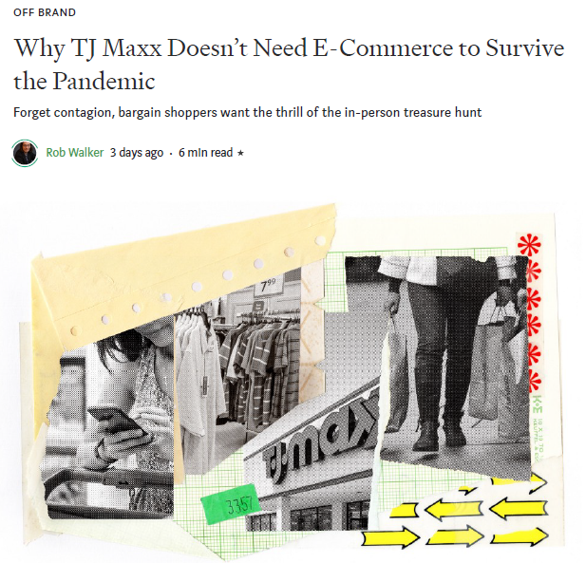
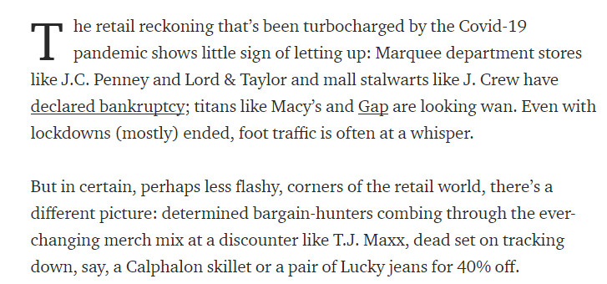
Changing Retail Landscape
https://marker.medium.com/why-tj-maxx-doesnt-need-e-commerce-to-survive-the-pandemic-2b9cb766cedc

Slide 18
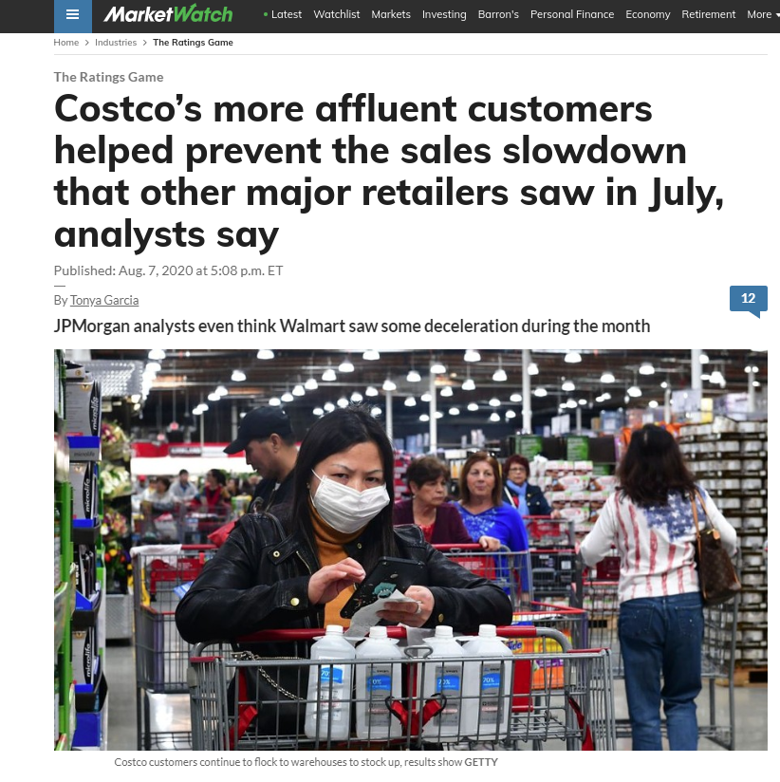
Changing Retail Landscape
https://www.marketwatch.com/story/costcos-more-affluent-customers-helped-prevent-the-sales-slowdown-that-other-major-retailers-saw-in-july-analysts-say-2020-08-06

Slide 19
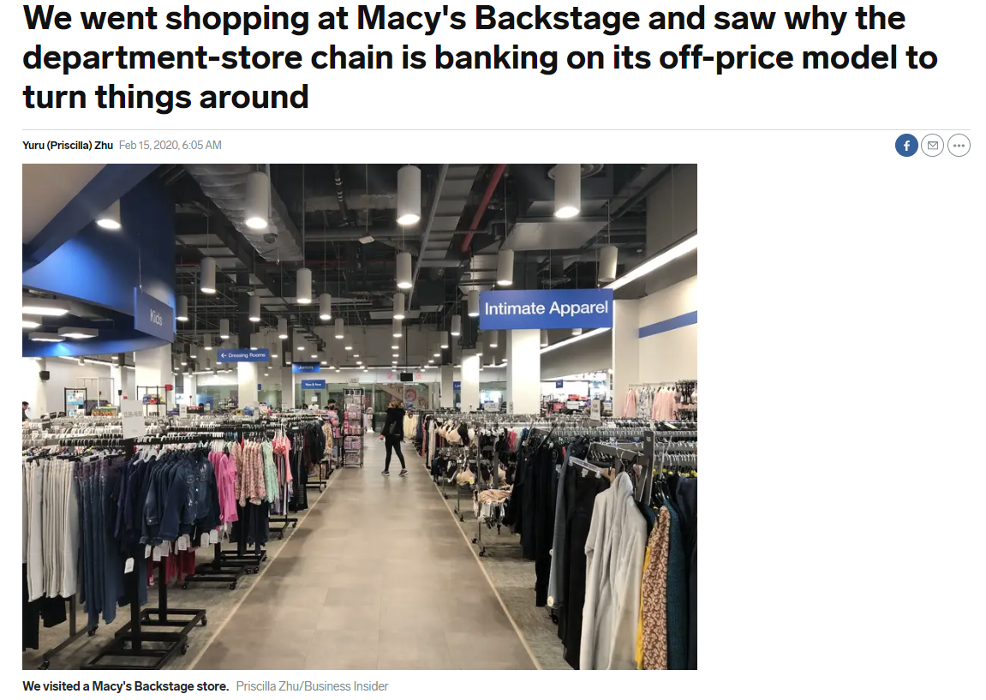
Changing Retail Landscape
https://www.businessinsider.com/macys-backstage-photos-why-macys-opening-more-2020-2

Slide 20
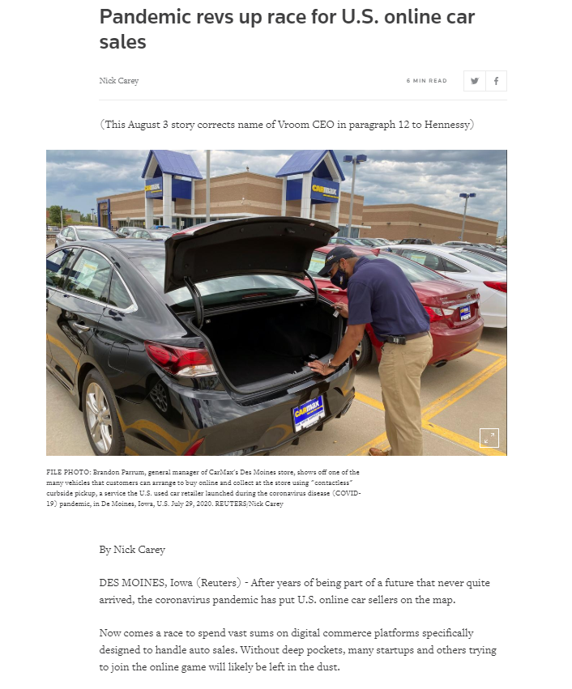
Auto Sales Also Going Online
https://www.reuters.com/article/us-usa-autos-online-sales-focus/pandemic-revs-up-race-for-u-s-online-car-sales-idUSKBN24Z1BZ

Slide 21
Key Items to Sales Tax Forecasting in an “Era of Uncertainty”
COVID situation is fluid, no one can predict the outcome, therefore the timing and speed of economic recovery remains uncertain.
“Average” recession over past four decades lasts approximately 6 quarters, which would put beginning recovery in 3-4Q of 2022.
Consumer spending behavior was already changing before COVID, shifting to online and “treasure” hunting.
“V-shaped” recovery seems less likely as COVID lingers.
Local economic impacts could factor more than national factors (layoffs, corporate relocations, tourism impact, cost of living issues, etc.)

Slide 22
Forecasting: Understanding Your Sales Tax Categories

Slide 23
Forecasting: Understanding Your Sales Tax Categories

Slide 24
Forecasting: Factors “Unique” to Snoqualmie
City had one-time adjustment taking $177K away in 2019.
Closures occurred in March and April dropping revenues for those months, however those are usually the months with the lowest sales tax activity.
City is projecting 50-75% drop in “brick and mortar” businesses (excluding construction) for summer months as tourism and large events typically held in the City have been cancelled.
City does not have fast food locations nor large retail outlets; residents have always shopped more frequently online than national average, online sales are booming.
Council is deliberating a set of policy decisions that may build and expand the City’s sales tax base.

Slide 25
Snoqualmie Sales Tax Forecast

Slide 26
Summary
Each city, county and local jurisdiction forecasting revenue has unique factors that need to be incorporated in forecasts.
Do not make brash forecasts based on incomplete data; make sure you have backing data and support for any forecast you present to your governing body.
It is 100% certain that the COVID situation will change, ensure that you are conveying that message with your forecasting, and updating your governing body at least quarterly.
Make sure you are capturing the shift in consumer spending habits to e-commerce and “treasure” hunting, that was occurring pre-COVID and will continue.

Slide 27

Questions

