Slide 1
Fraud and Internal Controls – The Good, the Bad and the Ugly
Presentation for the Puget Sound Finance Officers Association
November 13, 2019
Robert Goehring, CFE, CPA, City Auditor
rgoehring@kentwa.gov

Slide 2
Source: erpforidaho.com

Slide 3
Biography
City Auditor, City of Kent (September 2002 through current)
Washington State Auditor’s Office (August 1987 – August 2002, last three years with Special Investigations)
Director at Large (six years as President), Pacific Northwest Chapter/ACFE (July 2002 – Current)
3

Slide 4
Biography - Continued
Graduate of Central Washington University (Accounting)
Enjoys making pies and greeting cards and listening to both kinds of music – Barbara Streisand and Neil Diamond
A strong proponent of nuclear power (“Hanford Corner” in office, complete with a Geiger Counter)
4

Slide 5
Disclaimer
The views and opinions expressed do not necessarily reflect the views and opinions of the City of Kent, or City elected officials, management or staff.
5

Slide 6
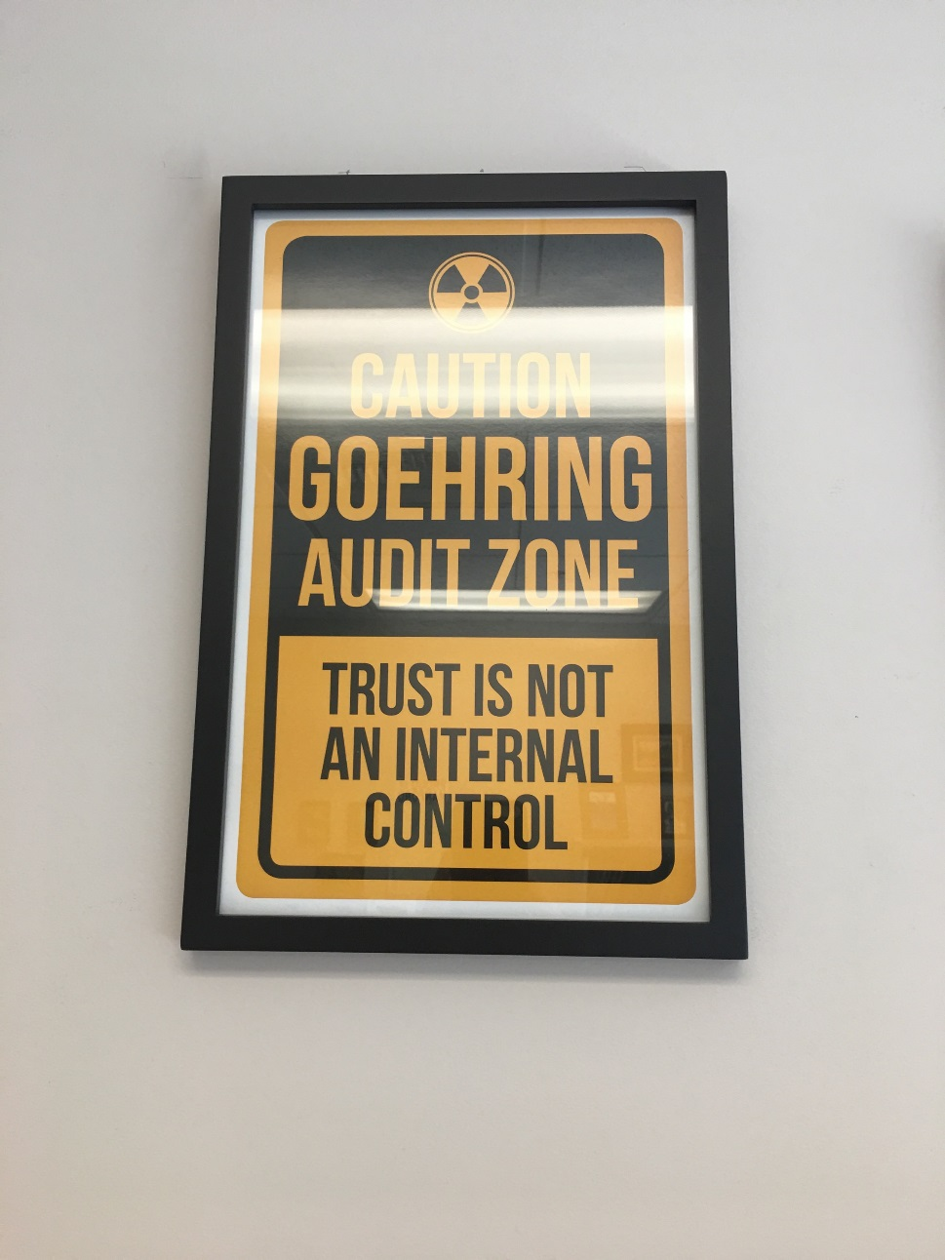
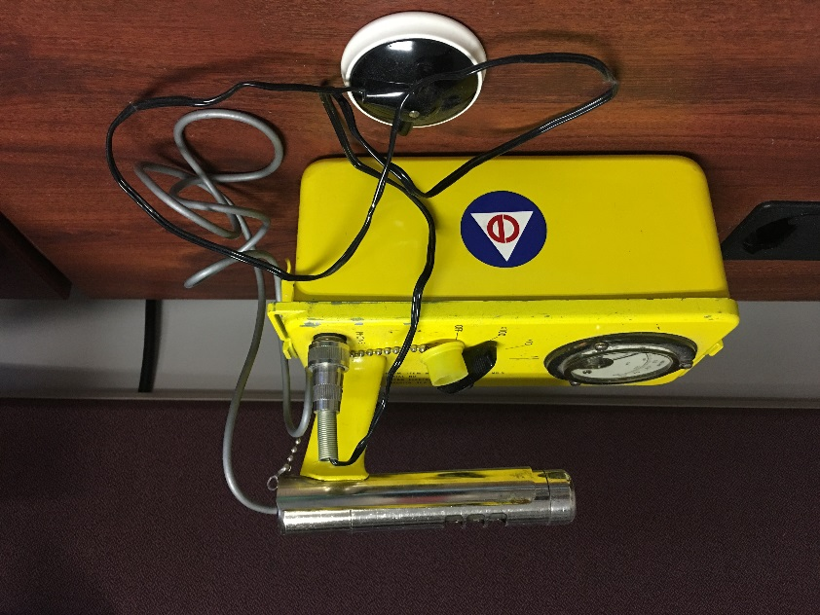
Batteries?
6

Slide 7
Some Things that Fraudsters Do Not Consider
Rather to fail with honor than succeed by fraud. – Sophocles
Some people change their ways when they see the light; others when they feel the heat. – Caroline Schroeder
Let the punishment be equal with the offense – Cicero (if only this was true)
7

Slide 8
Some Things - Continued
Success will come and go, but integrity is forever. – Amy Rees Anderson
Be honorable yourself if you wish to associate with honorable people – Welsh Proverb
8

Slide 9
Agenda
November 2018 PSFOA Presentation Summary
COSO Integrated Internal Control Framework (Overview)
Audit Risk Heat Maps – Accounting System, Department and Operation
Check-for-Cash Substitution Scheme
9

Slide 10
Agenda - Continued
Accounts Receivable Lapping Scheme
Fraud Casebook Lessons from the Bad Side of Business:
A New York State of Mind
The Skim Sisters
10

Slide 11
Agenda - Continued
Monitoring Exercise – Municipal Court Revenues
Concluding Thoughts
Additional Resources
11

Slide 12
November 2018 PSFOA Presentation Summary
ACFE 2018 Bi-Annual Report to the Nations:
On average, organizations lose an estimated 5% of their annual revenues to fraud (no change from prior reports)
Over $7.1 billion in total losses
12

Slide 13
Presentation Summary - Continued
Opportunity
Motivation
Rationalization
13

Slide 14
Presentation Summary - Continued
Fraud is a violation of a trust with the taxpayers (goes beyond dollars)
Proper tone at the top is critical in prevention of fraud
Trust is not an internal control
14

Slide 15
Presentation Summary - Continued
Anyone in an organization can commit fraud – Access, Skill and Opportunity
Internal controls are positional and situational, not personal (don’t place your staff at risk)
Employees respect what you inspect not expect (fraudsters don’t play by the rules)
15

Slide 16
Presentation Summary - Continued
Importance of:
Knowing your financial operations including asking “what could go wrong?”
Assessing impact and likelihood of occurrence of an adverse event
Proper segregation of duties
16

Slide 17
Presentation Summary - Continued
Importance of - Continued:
Proper audit trail (complete and accurate financial story)
Proper monitoring of financial operations and timely and effective follow-up on exceptions
Leveraging resources (you are not alone)
17

Slide 18
COSO Integrated Internal Control Framework
Risk-based framework whereby internal control:
Is a process not an end unto itself
Established by people at every level of the organization
Reasonable rather than absolute assurance measured in three separate overlapping categories
18

Slide 19
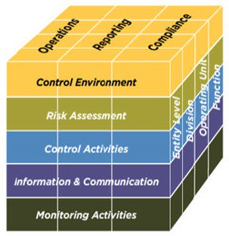
COSO IICF - Continued
19

Slide 20
COSO IICF - Continued
Five Overlapping Elements:
Objectives
Components
Levels
Principles
Points of Focus
Visualized through the Integrated Internal Control Framework Cube
20

Slide 21
COSO IICF - Continued
Three Objectives:
Operations
Reporting
Compliance
Five Components:
Control Environment
Risk Assessment
Control Activities
21

Slide 22
COSO IICF - Continued
Five Components - Continued:
Information and Communication
Monitoring Activities
Four Levels:
Entity Level
Division
Operating Unit
Function
22

Slide 23
COSO IICF - Continued
17 Principles:
Representing fundamental concepts associated with each Component of an effective internal control system, each supported by one or more Points of Focus.
77 Points of Focus:
Important characteristics of one or more Principles (five impact more than one)
23

Slide 24
COSO IICF - Continued
Illustration:
Control Environment (five Principles)
Selected Principle – Commitment to integrity and ethical values
Two Selected Points of Focus – Sets the Tone at the Top and establishes Standards of Conduct
24

Slide 25
Audit Risk Heat Map –Illustrative Only
Accounting System
Journal Entries
Payroll
Receipting
Small & Attractive Capital Assets
Credit Cards
Accounts Payable
Disbursements
(e.g. Wire Transfers)
Capital Assets

Slide 26
Audit Risk Heat Map – Continued
Department
Equipment Rental
Parks
Finance
Fire
Court
Police
Public Works

Slide 27
Audit Risk Heat Map – Continued
Operation - Likelihood
Fuel Island
Construction Contracts
Travel
Credit Cards
Outgoing Wire Transfers
Overtime

Slide 28
Audit Risk Heat Map – Continued
Operation - Impact
Outgoing Wire Transfers
Fuel Island
Travel
Construction Contracts
Credit Cards
Overtime

Slide 29
Check-for-Cash Substitution Scheme
The Scheme: Recorded customer cash payments are replaced by unrecorded customer check payments
Fraudster prepares separate deposit ticket (false) for transmittal with the accounting records
Fraudster prepares separate deposit ticket (correct) for transmittal with the money to the bank
29

Slide 30
Check-for-Cash Substitution Scheme - Continued
The Result: Total receipts agrees to total deposit ticket; however, cash (stolen) is short to receipts
The Solution: Always verify check and cash composition per the accounting records to the bank-validated deposit ticket or equivalent record from the bank
30

Slide 31
Receipting System
Deposit Ticket
John Smith
Sue James
Rex Long
Total Cash
Rob Brown
Kim Jones
Total Checks
Total Revenue
$1,000
500
700
$2,200
Currency
Checks:
Rob Brown
Kim Jones
Mary Hanks
Total Checks
Total Deposit
$1,300
$ 500
800
900
$2,200
$ 500
800
$1,300
$3,500
$3,500
31

Slide 32
Accounts Receivable Lapping Scheme
The Scheme: Stolen customer payment is replaced by payment(s) received from another customer
Customer A pays $100 for their utility bill (stolen)
Customer B pays $100 for their utility bill
32

Slide 33
Accounts Receivable - Continued
Fraudster applies $100 of Customer B payment to Customer A account
Customer C pays $100 to their account
Fraudster applies Customer C payment to Customer B account
33

Slide 34
Accounts Receivable - Continued
Fraudster eventually records false write-off or non-cash credit (e.g. false leak adjustment) to make shorted accounts whole
Usually requires creation of detailed records outside of the victim organization’s accounting system
34

Slide 35
Fraudster’s House of Cards –
Before and After
Source: shutterstock.com
35

Slide 36
Case Study: Water District
Perhaps the best illustration of an accounts receivable lapping scheme
1997
Loss: $357,237
Perpetrator: Accounts Receivable Clerk
Sentencing: Plead guilty - 33 months
36

Slide 37
Case Study - Continued
Primary Scheme: Accounts Receivable Lapping – over 4,000 accounts (23%)
Other schemes:
Check-for-cash substitution
Unauthorized account write-offs and adjustments
Detection: Routine SAO annual audit
37

Slide 38
Case Study - Continued
Red Flags – Partial List:
Segregation of duties problem
Very little cash in deposits
Delinquent accounts receivable and adjustments not monitored
Irregular documents present in utility stub batches and many changes
38

Slide 39
Fraud Casebook Lessons from the Bad Side of Business
Published by the ACFE
62 fraud cases in the following areas:
Asset Misappropriation (41)
Corruption Schemes (nine)
Financial Statement Schemes (six)
Other Schemes (six)
39

Slide 40
Fraud Casebook - Continued
Brief walk-through of two cases used by Kent Internal Audit for Finance Department Newsletter
Articles incorporated Internal Audit observations
40

Slide 41
Fraud Casebook - Continued
“A New York State of Mind” by Martin T. Biegelman, CFE
Kent Internal Audit Alternate Title: “A New York State of Fraud – A Den of Thieves Making Music Together”
41

Slide 42
Fraud Casebook - Continued
New York Insurance Fraud Task Force
256 defendants – Over $500 million in losses impacting nearly every U.S. insurance company
Licensed public adjusters – Represent claimant
42

Slide 43
Fraud Casebook – Continued (New York)
NY Public adjusters usually receive 5% to 10% commission for recoveries
Kickbacks paid by public adjusters to insurance company adjusters and/or experts to inflate property insurance claims
43

Slide 44
Fraud Casebook – Continued (New York)
Public adjusters typically received up to 50% of settlements, then split the money with other participants
First case:
Discount Furniture Store
Minor fire damage (arson)
44

Slide 45
Fraud Casebook – Continued (New York)
First case - Continued:
Store submitted $10,000 claim
Public adjuster, insurance company adjuster and salvage expert conspired with store to submit $100,000 claim
45

Slide 46
Fraud Casebook – Continued (New York)
First case - Continued:
Claim was never paid
Public adjuster and insurance company adjuster agreed to cooperate
Salvage expert sent to prison
46

Slide 47
Fraud Casebook – Continued (New York)
First case - Continued:
Resulted in numerous defendants awaiting trial for other cases to plead guilty
Sentencing for 256 defendants ranged from probation to 15 years in prison plus fines and restitution
47

Slide 48
Fraud Casebook – Continued (Hotel)
“The Skim Sisters” by Adam K. Bowen, CFE, CPA, M.Acc
Kent Internal Audit Alternate Title: “Fraudsters that Check-in, But Don’t Check Out”
Scheme – Vacancy Fraud
$95,000 (Ten-Month Period)
48

Slide 49
Fraud Casebook – Continued (Hotel)
Upscale hotel in Atlanta (200 rooms - $16 Million Annual Revenues)
Typically rooms taken out of service for maintenance (not unusual)
Front Desk Operations Manager hired lifetime friend as Director of Housekeeping
49

Slide 50
Fraud Casebook – Continued (Hotel)
Front Desk Operations Manager offered guests without reservations up to 50% discount if paying by cash (think also checks)
Customer assigned to room that was not officially in service
Stay not recorded to hotel reservation system or point of sale system
50

Slide 51
Fraud Casebook – Continued (Hotel)
Director of Housekeeping would clean the room and typically received $100 cash per week beyond regular salary
Manager typically worked double-shifts and rarely took vacations
Fraud grew from one or two rooms per week to approximately ten per week
51

Slide 52
Fraud Casebook – Continued (Hotel)
Customer complained to the Desk Clerk that he did not receive promised refund because his room was not serviced on a regular basis
Fraud detected after Desk Clerk reported concern to management and investigation which included interviewing the customer
52

Slide 53
Fraud Casebook – Continued (Hotel)
Fraud likely could have also been committed if customers paid by check
Director of Housekeeping testified (three years probation - $10,000 restitution)
Front Desk Operations Manager (five years prison - $100,000 restitution)
53

Slide 54
Monitoring Exercise - Municipal Court Revenues
The number of citations issued during 2018 increased by 15% from 2017
2018 Court fines and forfeiture revenues decreased by 10% from 2017
IS THIS FRAUD?
Recognize the issue, follow-up, document, and communicate
54

Slide 55
Monitoring Exercise – Continued
Next steps:
Determine if reasons provided, if any, are valid
Document and communicate results to management
Must notify SAO if known or suspected loss of public funds (RCW 43.09.185)
55

Slide 56
Monitoring Exercise – Continued
Some potential valid explanations:
Increase in number of Failure to Appears (FTAs)?
Increase in referrals for collection?
Increase in number of case dismissals and/or reductions in fine?
56

Slide 57
Monitoring Exercise – Continued
Some other potential “red flags”:
Reconciled Court checking account balance less than Court Trust Account subsidiary report
Unauthorized waivers or reduction of fines (think JIS Accounts Receivable Adjustments Report)
Manual receipts not recorded to Judicial Information System
57

Slide 58
Concluding Thoughts
Taxpayers expect that public funds are reasonably safeguarded from waste, theft and abuse, and are used for valid and allowable purposes.
Employees expect that they are reasonably protected from being falsely accused of waste, theft and abuse of public funds.
58

Slide 59
Concluding Thoughts - Continued
Fraud happens, even in state and local government
The keys to fraud prevention are awareness of financial operations, effective internal controls, and timely and effective monitoring
59

Slide 60
Additional Resources
Association of Certified Fraud Examiners (www.acfe.org)
Pacific Northwest Chapter/ACFE (www.fraud-examiners.org)
The Institute of Internal Auditor Nisqually Chapter
(www.chapters.theiia.org/Nisqually)
60

Slide 61
Additional Resources - Continued
Washington State Auditor’s Office (www.sao.wa.gov)
Book: “Fraud Casebook Lessons from the Bad Side of Business” published by the ACFE (available from the ACFE and various retailers)
61

Slide 62
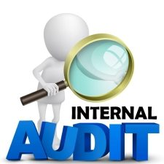
Questions?
Robert Goehring, CFE, CPA
City Auditor
City of Kent Finance Department rgoehring@kentwa.gov
(253) 856-5262
62

